Slide 1

SHRI B.V.V.SANGHA’S BASAVESHWAR ENGINEERING COLLEGE , BAGALKOT DEPARTMENT OF INFORMATION SCIENCE AND ENGINEERING AI BASED CHATBOT Under the guidance Prof G.M.Patil
Project Associates
Mallikarjun R J 2BA19IS037
Udayakumar M H 2BA19IS075
Prajwal B Majjigi 2BA19IS051

Slide 2
Contents
Abstract
Chapter 1 : Introduction
Motivation
Objectives
Scope of project
Literature survey
Chapter 2: Problem formulation
Introduction
Present System
Proposed System
Problem Statement
Chapter 3: Requirements
Functional Requirements
Non-Functional Requirments
Hardware and Software Requirements

Slide 3
Abstract
There have always been queries of people regarding various topics to which answers are provided manually by people. In order to make this process fast the FAQs can be answer using the latest AI technologies where answers can be automatically generated according to the questions. This process can reduce lot of work pressure for both the consumer and the companies. Also providing quick responses and suggestions can help in the better economical market growth.

Slide 4
Motivation
Chatbots can make easy for users to find the information they need by responding to their questions and requests—through text input, audio input, or both—without the need for human intervention.
Chatbot technology is almost everywhere these days, from the smart speakers at home to messaging applications in the workplace. The latest AI Chatbots are often referred to as ’virtual assistants’ or ‘virtual agents’. Chatbot can use audio input, such as Apple's Siri, Google Assistant and Amazon Alexa. Either way, user able to ask questions about what user need in a conversational way, and the Chatbot can help refine user search through responses and follow-up questions.

Slide 5
Objectives
Our project motive is to build AI based Chatbot to answer FAQs.
To answer the Frequently Asked Questions (FAQs) with quick and fast response.
To provide answer reduce ambiguity and confusion.

Slide 6
Scope of Project
With efficient Chabot development practices, they can be made capable of literally engulfing and processing whatever information comes their way.
They learn and develop a predictive analytical capability just like humans. Eventually, all they need is a stimulus.

Slide 7
Literature Survey
A Chatbot is an agent that interacts with users using natural language. The sample application is built with Flask, Visual Studio code, and JSON Artificial Intelligence Markup Language. Describes the content of the first AI course is a series of tasks that enable to work with intelligent specialists and other AI systems for scanning, channeling and recovery of relevant information from the Internet` [1].
A chatbot is one of the simple ways to transport data from a computer without having to think for proper keywords to look up in a search or browse several web pages to collect information; users can easily type their query in natural language and retrieve information. Chatbot is a great tool for quick interaction with the user. They help us by providing entertainment, saving time and answering the questions that are hard to find [2].
A chat-bot is a computer programmed based on the AIML (artificial intelligence markup) and NLP, which communicates with the messaging system. Any questions will be asked by an individual and chat-bot will reply. A chat-bot is now extremely common and uses speed as a communication application for computersA Chatbot refers to a chatting robot. It is a communication simulating computer program. It is all about the conversation with the user. The conversation with a Chatbot is very simple. It answers to the questions asked by the user [3].

Slide 8
Introduction
There have always been queries of people regarding topics to which answers are provided manually by people .
In order make this process fast FAQs can be answered using AI Chatbot.
Answers can automatically generated and answered according to questions.
This process can reduce a lot of work pressure for service provider(companies) and consumer(client).
Application helps to engage/attract more clients/users hence increasing economical growth to company.

Slide 9
Present System
In present system most of questions are manually answered by different sources for same questions.
Most of websites doesn’t have AI Chatbots to answer user queries.
Present Chatbots cannot understand query, if it is not properly and fully specified.
Human resource is needed to provide answers and maintenance.

Slide 10
Proposed System
AI Chatbot provides all time availability and instant response with clear and accuracy.
Consistency in answers.
Minimum error and less biased replies.
Improved customer satisfaction with much improved answers .

Slide 11
Problem Statement
To develop a web-based application as Chatbot using the latest AI technology to answer the frequently asked questions. AI based Chatbot to answer the FAQ’s.

Slide 12
Functional Requirements
The application provides assistance regarding FAQs with accurate responses.
For general queries user can directly access the Chatbot.
Interaction with Chatbot for various FAQs.

Slide 13
Non-Functional Requirements
Responsiveness: Quality and sudden responses are made.
Instantaneous :Instant reply.
Secured :Interactions are not shared they are secured . It protects from unauthorized access.
Availibility :Can be accessed at any time .
Reliability: It is probability that a product will perform its function adequately or correctly for a specified period of time.

Slide 14
Hardware requirements
Ram 4GB or More.
Hard disk capacity 50GB or more.
Software requirements
Frontend:HTML CSS,JS
Backend : Python

Slide 15
Contents
Design
Architecture
Use Case Diagram
Sequence Diagram
Implementation
Flowchart
Implementation Of Project
Pseudo code

Slide 16
Architecture
Us
Find for the
best match
User query
gui
s
GUI
System
(JSON)
Selection of
best match
System response

Slide 17
Use Case Diagram
Chatbot
A
Ask Questions
SYSTEM
Receive Answers
user

Slide 18
Sequence Diagram
User
GUI
Chatbot
Send query
Sent to compare
Generate
response
Display
response

Slide 19
Flowchart
Start
Access Website
Have Any Queries?
Yes
Ignore the chatbot
No
Have any queries?
Ask the question
Sign up
Generate Response
Pattern matching
(Json)
Exit

Slide 20
Algorithm
Step 1: Start
Step 2: chatbot Interface
Step 3:Session Start Interacting with chatbot
Step 4:User queries
Step 5:loads json into intents next step
Step 6:Read tockenize pattern split word into array and
stem each word - create short form for word
Step 7:Get Valid Resonse and go to step 4
Step 8: End

Slide 21
Contents
Testing
Different steps of Testing
Test Cases
Snapshots
Conclusion

Slide 22
Different steps of testing
The most practical test for our system will be to have a testing .Such that all of its functions
are covered while trying to do interaction with the Chabot.
Cases and stipulations to test for:
1.User is able to access the Chabot easily.
2.User able to communicate with the Chabot.
3.To get the satisfied answers by the Chabot.
Black Box Testing
1.Validation Testing
White Box Testing
1.Unit Testing
2.Integration Testing

Slide 23
Testing methods
Black Box Testing
This method of software testing tests the functionality of an application as opposed to its internal structures or working(i.e. white box testing). Specific knowledge of the application’s code/internal structure and programming knowledge, in general, is not required. Test cases are built to specifications and requirements, i.e., what the application is supposed to do. It uses external descriptions of the software, including specifications, requirements, and design to derive test cases. These tests can be functional or non-functional, though usually functional. The test designer selects valid and invalid inputs and determines the correct output.
There is no knowledge of the test object’s internal structure.
1.Validation Testing
Validation Testing can be defined in many ways, but a simple definition is that validation
succeeds when the software functions in a manner that can reasonably expected by a user.
and the user is satisfied by the responses.

Slide 24
White Box Testing
This method of software testing tests internal structures or workings of an application, as opposed to its functionality (i.e. black-box testing). In white-box testing, an internal perspective of the system, as well as programming skills, are required and used to design test cases. The tester chooses inputs to exercise paths through the code and determine the appropriate outputs.
1.Unit Testing
in this testing we test if individual units of source code are fit for use.A unit is the
smallest testable part of an application. In procedural programming a unit may be
an individual function or procedure. Each test case is independent from the others.

Slide 25
2.Integration Testing
This testing is sometimes called Integration and Testing. Integration testing is the phase
in software testing in which individual software modules are combined and tested as a group.
It occurs after unit testing and before system testing. Integration testing takes as its
input module that have been unit tested, groups them in larger aggregates, applies tests defined
in an integration test plan to those aggregates and delivers as its output the integrated system
ready for system testing.

Slide 26
Test Cases
Number | Input given | Expected output | Actual output | Test pass | Remarks
1 | Hi | Hi there, how can I help? | Hi there, how can I help? | Pass
2 | Are the classes free? | Yes. Access to the online course resources is free. A nominal fee is applicable if you want to take the in-person proctored online examination | Yes. Access to the online course resources is free. A nominal fee is applicable if you want to take the in-person proctored online examination | Pass
3 | 1 2 | Sorry, can't understand you | Sorry, can't understand you | Pass
4 | asbc#$_ | Sorry, can't understand you | Sorry, can't understand you | Pass

Slide 27
Test Cases
Number | Input given | Expected output | Actual output | Test pass | Remarks
5 | What is the fee for the certification exam? | The fee will be posted on the portal prominently. And depends on the type of course. We expect it to be around Rs. 1000. | The fee will be posted on the portal prominently. And depends on the type of course. We expect it to be around Rs. 1000. | Pass
6 | who can register for course? | NPTEL online courses are open to everyone. The courses of all domains are available to register and learn from all different educational backgrounds. | NPTEL online courses are open to everyone. The courses of all domains are available to register and learn from all different educational backgrounds. | Pass
7 | what is the course duration? | The course duration will be for about 4,8 and 12 weeks | The course duration will be for about 4,8 and 12 weeks | Pass

Slide 28
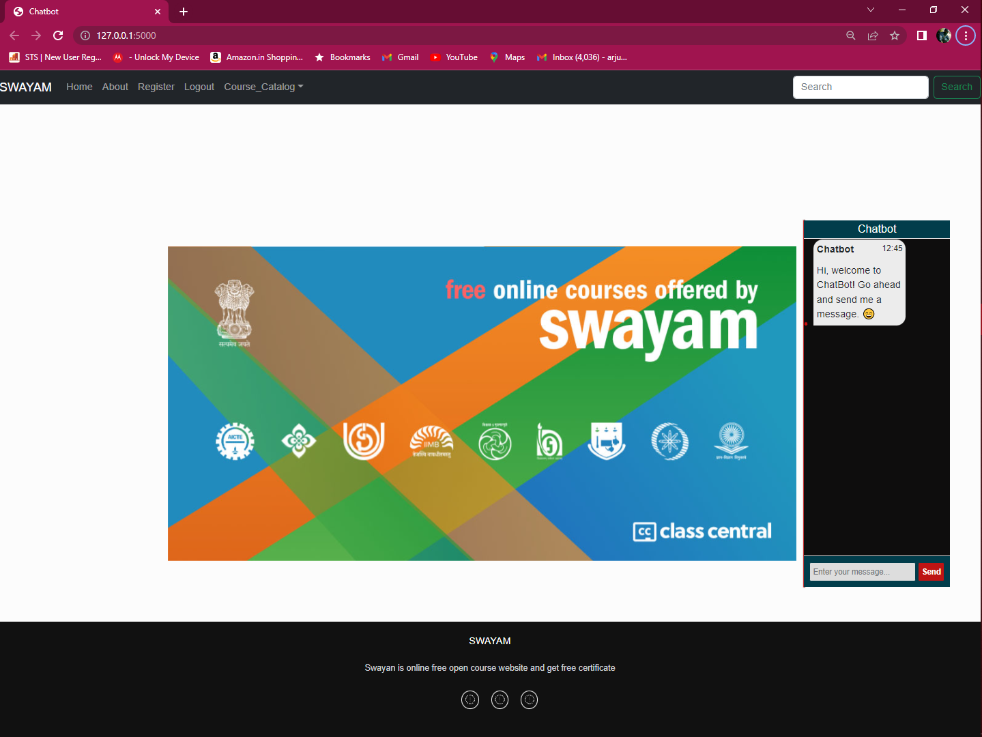
Snapshot

Slide 29
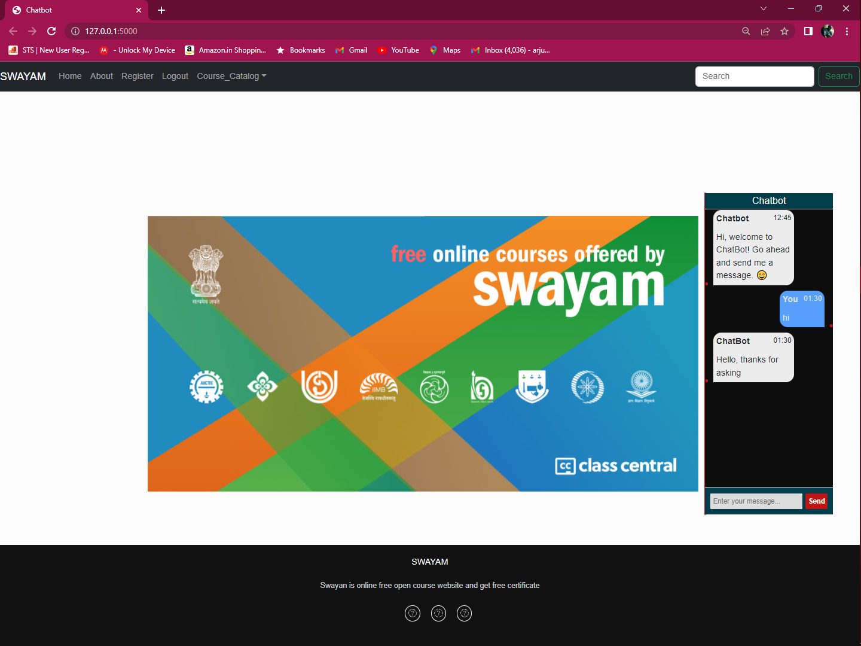
Snapshot

Slide 30
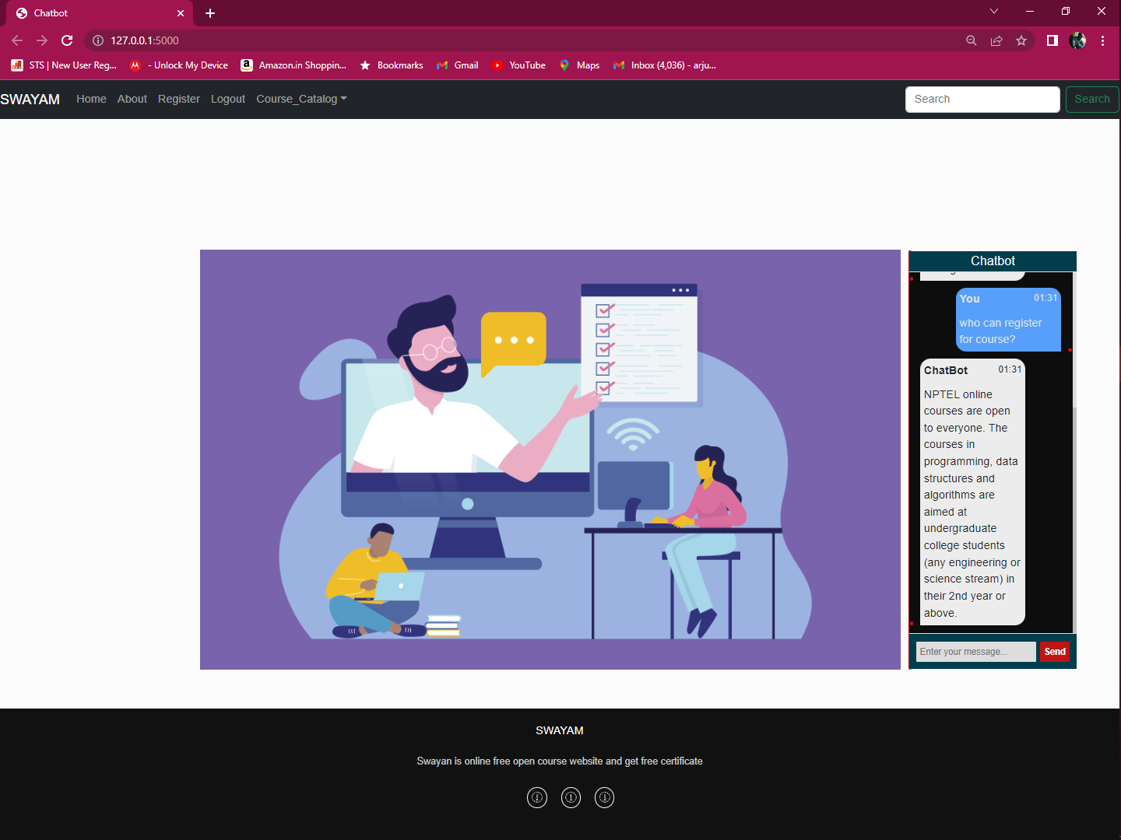
Snapshot

Slide 31
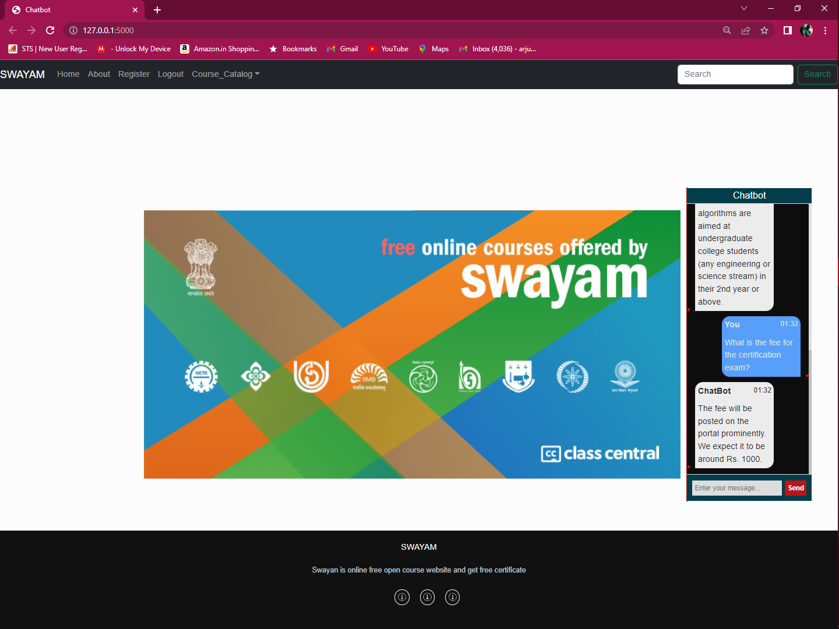
Snapshot

Slide 32
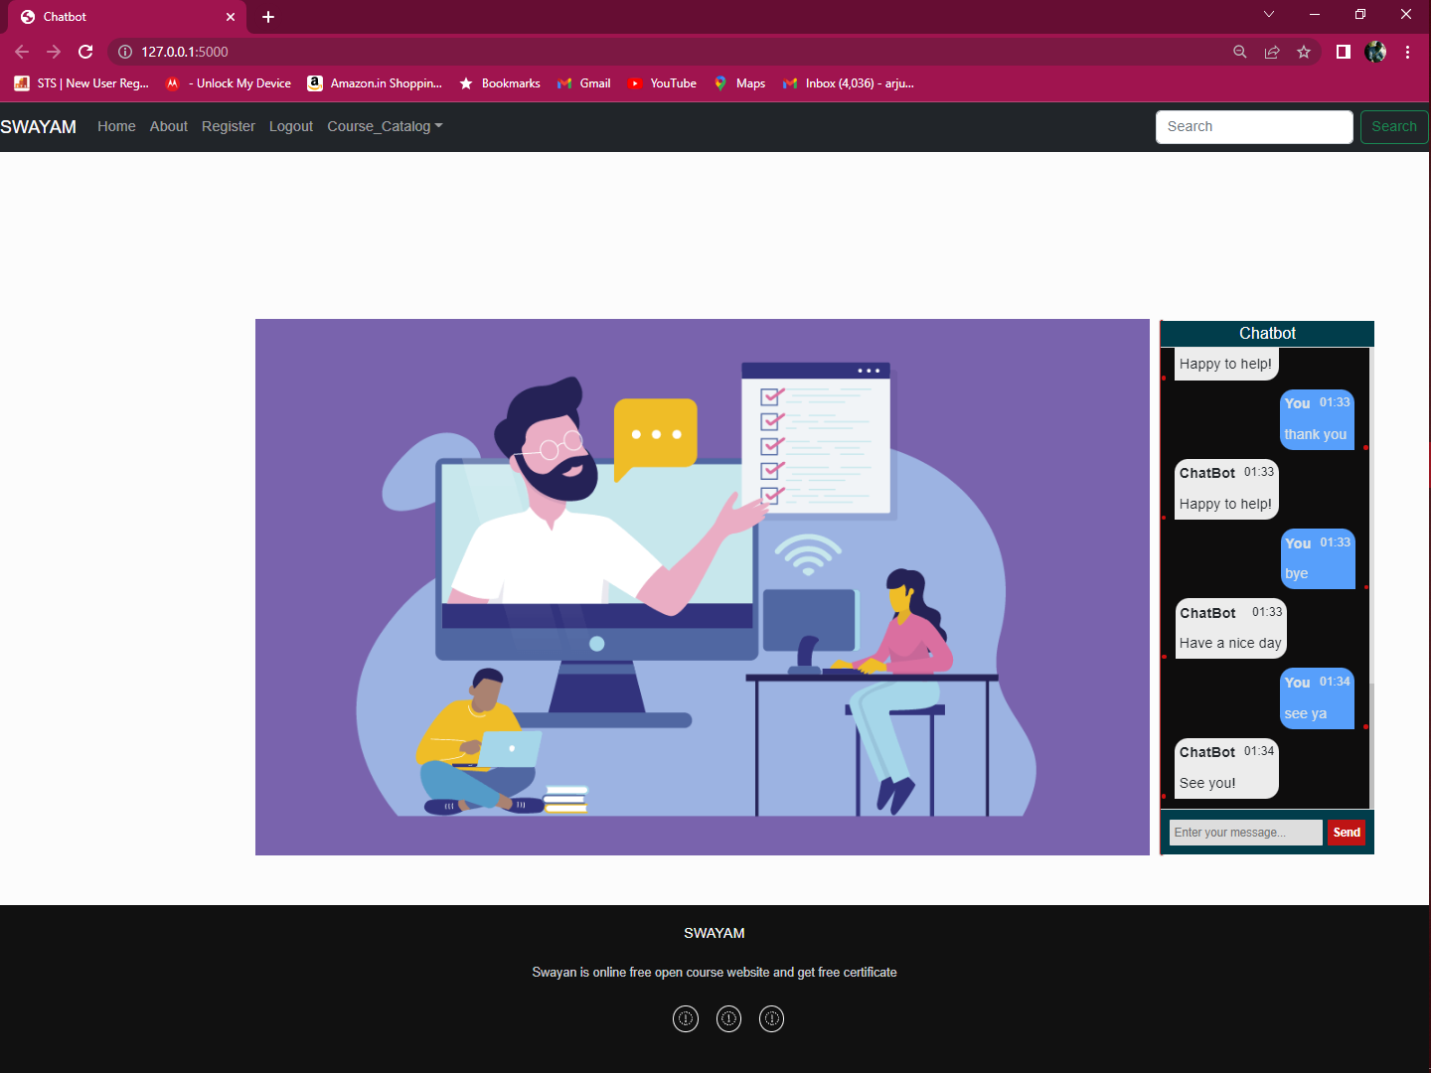
Snapshot

Slide 33
Conclusion
Implementing the “AI based Chabot to answer the FAQ’s “ online application.The whole system helps easy access to the chatbot system. Physical presence of the human is not required. The time taken to give the responses to the large user/community is largely reduced.
This application provides the user with ease of access, user friendliness and transparency. On the other hand from organizations and government viewpoint, it helps in maintaining the easy access of website through the hassle free queries.
Implementation of the proposed system will reduce the workload of all those who provide the manual answers to the user questions. So a large number of users can be handled in the same time with computer generated automated responses. So this is safe ,fast and
user friendly.

Slide 34
References
[1] “Commercial Utilisation Of Chat-Bot Using Python”, Manisha Tamboli, G. Jeevan Ashish, Madhaw Ram Sahu, Aish Kumari Sahu, Md. Khaja Mohiddin, Arpita Shukla,2021.
[2] Menal Dahiya, “A Tool of Conversation: Chatbot”, International Journal of Computer Sciences and Engineering, 2017 .
[3] Shreyashkar Sharma, “Chat-Bot Development Using Python”, International Journal of Creative Research Thoughts, 2020 IJCRT.
https://buffml.com/web-based-chatbot-using-flask-api/
https://www.kommunicate.io/blog/create-chatbot-in-flask-and-python/
https://www.geeksforgeeks.org/chat-bot-in-python-with-chatterbot-module/

Slide 35
THANK YOU

